Slide 1
Fresno County Multi-Jurisdictional
Housing Element Update
Community Workshop
August 31, 2022

Slide 2
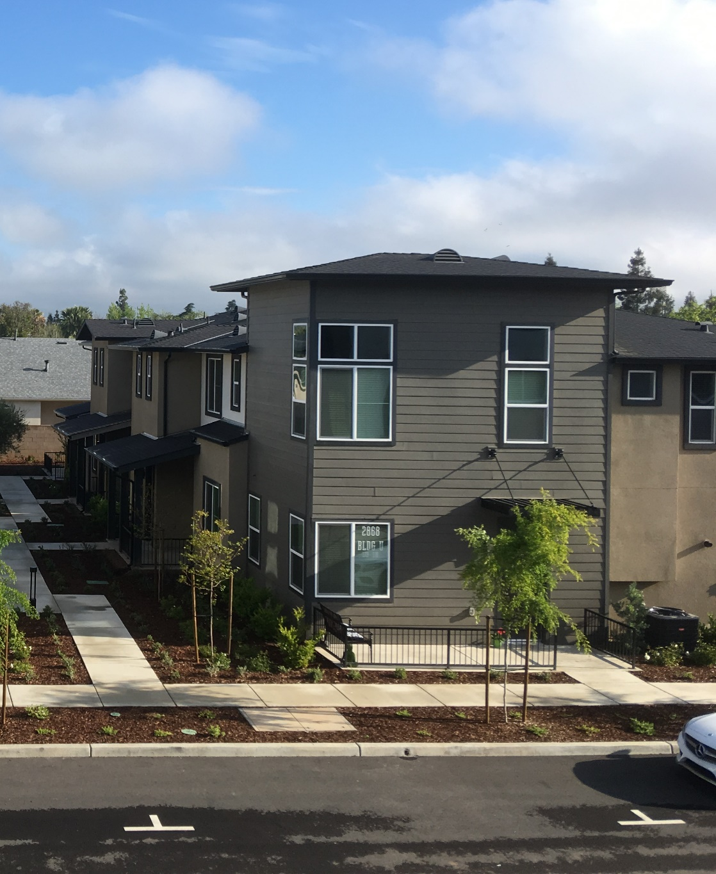
Agenda
Housing Element Overview/Contents
Regional Housing Needs Allocation (RHNA)
Housing Element Background Data
Introductions
Discussion

Slide 3
Project Team
FRESNO COUNCIL OF GOVERNMENTS
Fresno COG
Kristine Cai, Deputy Director
Simran Jhutti, Associate Regional Planner
Consultant Team
PlaceWorks
Ascent
Provost and Pritchard
California Coalition for Rural Housing

Slide 4
Meeting Objective
Provide an overview of the Housing Element Update process
Share information about housing needs to inform each jurisdiction’s housing plan
Gather initial community input on housing assets, issues, and opportunities

Slide 5
Project Schedule
Outreach
Admin. Draft Housing Element
Public Review Draft Housing Element (30-40 days)
Adoption Hearings
Submit to HCD – 1st Review (90 days)
Outreach
Submit to HCD – 2nd Review (60 days)
July – September 2022
January 2023
February 2023
December 2023
April – June 2023
February/ March 2023
August – September 2023
Public outreach and engagement will be conducted throughout the process.

Slide 6
Housing Element Overview/Contents

Slide 7
What is the Housing Element?
One of the eight mandated elements of the General Plan
Must be updated every 8 years
Adoption Deadline: December 31, 2023
6th Cycle Planning Period: December 31, 2023 – December 31, 2031
5th Cycle Planning Period: December 31, 2015 – December 31, 2023
Plan for accommodating the jurisdiction’s “fair share” of the regional housing need

Slide 8
Housing Element Contents
Needs Assessment
Housing Needs Assessment – analyzes demographic, employment, and housing needs
Fair Housing Analysis – identify barriers to equal housing opportunities
Housing Sites Inventory – identifies available sites for housing development or redevelopment
Analysis of Constraints – assesses governmental and non-governmental constraints on housing development
Evaluation of Previous Housing Element – measures progress and identifies gaps
Policies and Programs – establishes policies and programs to meet housing needs
Fair Housing Analysis
Policies and Programs
Sites Inventory
Constraints
Evaluation

Slide 9
Regional Housing Needs Allocation (RHNA)

Slide 10
How is the RHNA Determined?
State Role
Regional Role
Local Role
The State projects future housing needs at various income levels and allocates units to COGs Statewide
The COG develops a methodology to distribute housing needs to each jurisdiction; methodology approved by HCD
Cities and counties are allocated units. They must then find ways to accommodate – enough land at appropriate densities
Total RHNA = 2,502,971
Fresno COG RHNA = 58,298
Adopted June 2022

Slide 11
Fresno COG RHNA
Jurisdiction | RHNA Allocation | RHNA Allocation Percentage
Clovis | 8,977 | 15%
Coalinga | 566 | 1%
Firebaugh | 443 | 1%
Fowler | 339 | 1%
Fresno City | 36,866 | 63%
Huron | 319 | 1%
Kerman | 1,063 | 2%
Kingsburg | 882 | 2%
Mendota | 642 | 1%
Orange Cove | 469 | 1%
Parlier | 733 | 1%
Reedley | 1,463 | 3%
Sanger | 1,494 | 3%
San Joaquin | 200 | <1%
Selma | 1,492 | 3%
Unincorporated Fresno County | 2,350 | 4%

Slide 12
Fresno (city) RHNA by Income Level
Income Level | 2015-2023 RHNA (units) | 2023-2031 RHNA (units) | Percent Increase
Very Low Income (<50% of AMI) | 5,666 | 9,440 | 67%
Low Income (51-80% of AMI) | 3,289 | 5,884 | 79%
Moderate Income (81-120% of AMI) | 3,571 | 5,638 | 58%
Above Moderate Income (>120% of AMI) | 11,039 | 15,904 | 44%
TOTAL | 23,565 | 36,866 | 56%
Total of 15,324 Lower-Income Units
In comparison:
City of Clovis RHNA: 8,977
Fresno County RHNA: 2,350
2022 Fresno County Area Median Income (AMI) for a 4-person household = $80,300
Source: HCD 2022 Income Limits; FCOG RHNA Methodology, July 2022.

Slide 13
Housing Element Background Data

Slide 14
Households by Income Level
Source: 2014-2018 CHAS

Slide 15
How Affordable is Fresno County?
Jurisdiction | Units Sold | Median $ May 2022 | Median $ May 2021 | % Change Year to Year
Fresno County (countywide) | 1,135 | $400,000 | $346,500 | 15.4%
Coalinga | 25 | $290,000 | $225,000 | 28.9%
Firebaugh | 13 | $305,000 | $310,000 | -1.6%
Fowler | 15 | $455,000 | $404,750 | 12.4%
Fresno | 685 | $389,500 | $325,000 | 19.8%
Kerman | 12 | $328,000 | $295,000 | 11.2%
Kingsburg | 25 | $451,000 | $325,000 | 38.8%
Mendota | 2 | $193,500 | $225,000 | -14.0%
Parlier | 8 | $267,500 | $283,500 | -5.6%
Reedley | 24 | $320,000 | $305,000 | 4.9%
Sanger | 21 | $371,000 | $400,000 | -7.3%
Selma | 17 | $300,000 | $272,500 | 10.1%
Jurisdiction | Units Sold | Median $ May 2022 | Median $ May 2021 | % Change Year to Year
Unincorporated Fresno County Areas
Caruthers | 5 | $418,00 | $257,500 | 62.3%
Friant | 14 | $506,500 | $755,000 | -32.9%
Prather | 3 | $369,000 | $505,000 | -26.9%
Riverdale | 3 | $285,000 | $310,500 | -8.2%
Shaver Lake | 13 | $700,000 | $697,500 | 0.4%
Squaw Valley | 7 | $435,000 | $271,500 | 60.2%
Jurisdiction | Units Sold | Average
*Huron | 8 | $201,676
*Orange Cove | 25 | $329,796
*San Joaquin | 13 | $304,931
* Data gathered from survey of Zillow and Redfin
Source: CoreLogic, California Home Sale Activity by City (May 2022) and Redfin and Zillow, 2021- 2022

Slide 16
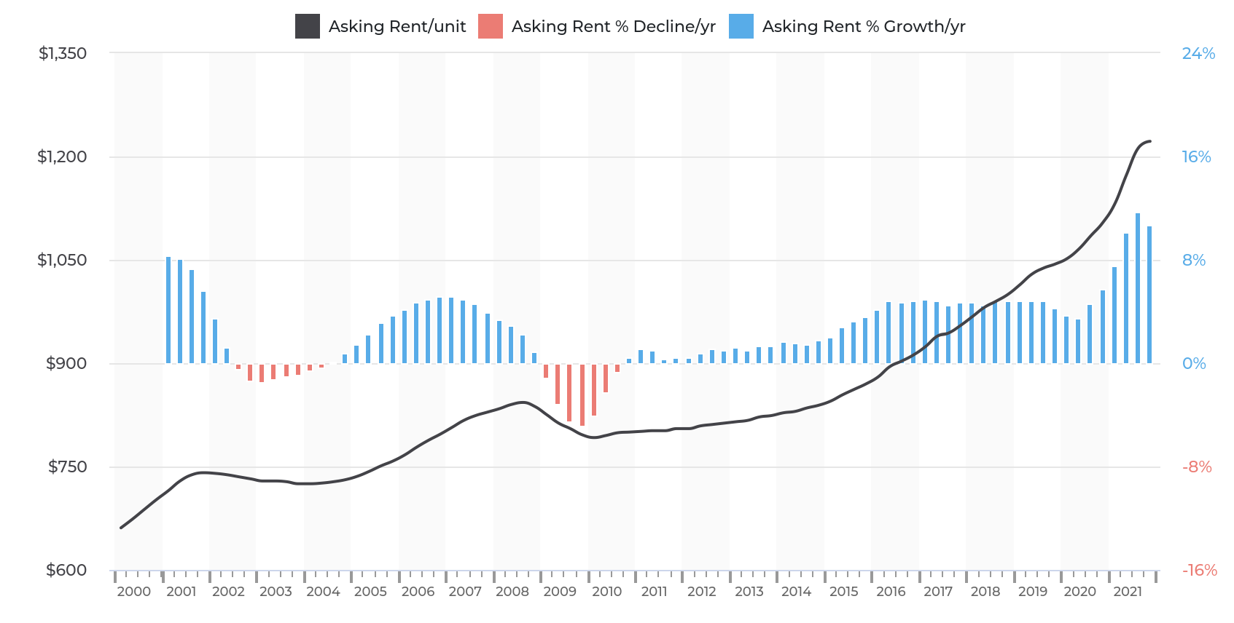
Rent Trends in Fresno County
Asking rents in Fresno County increased by 10.7% between Q4 2020 and Q4 2021.
Source: California Housing Partnership, 2022.

Slide 17
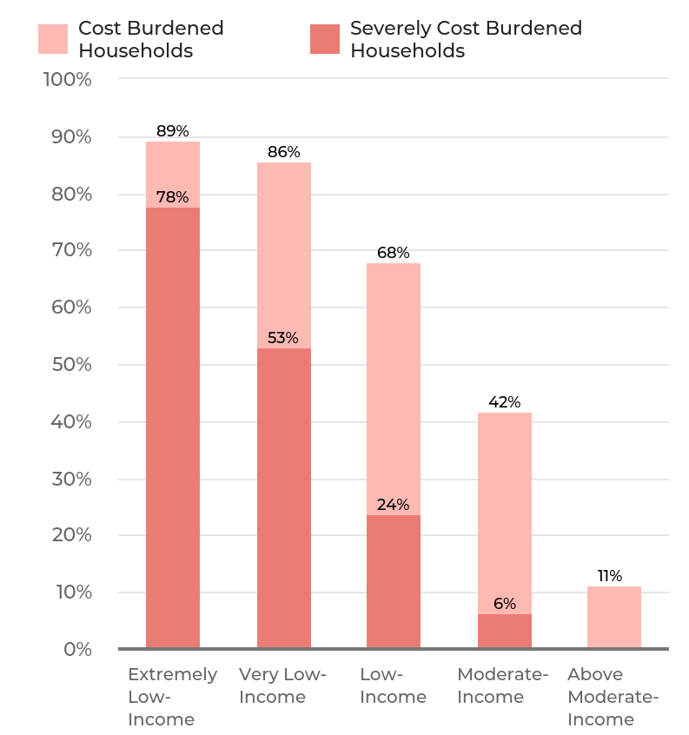
Who is Affected by High Prices in Fresno (city)?
Housing Cost Burden refers to households overpaying for housing
Cost Burdened = Paying more than 30% for housing
Severely Cost Burdened = Paying more than 50% for housing
Source: 2014-2018 CHAS and California Housing Partnership, 2022.

Slide 18
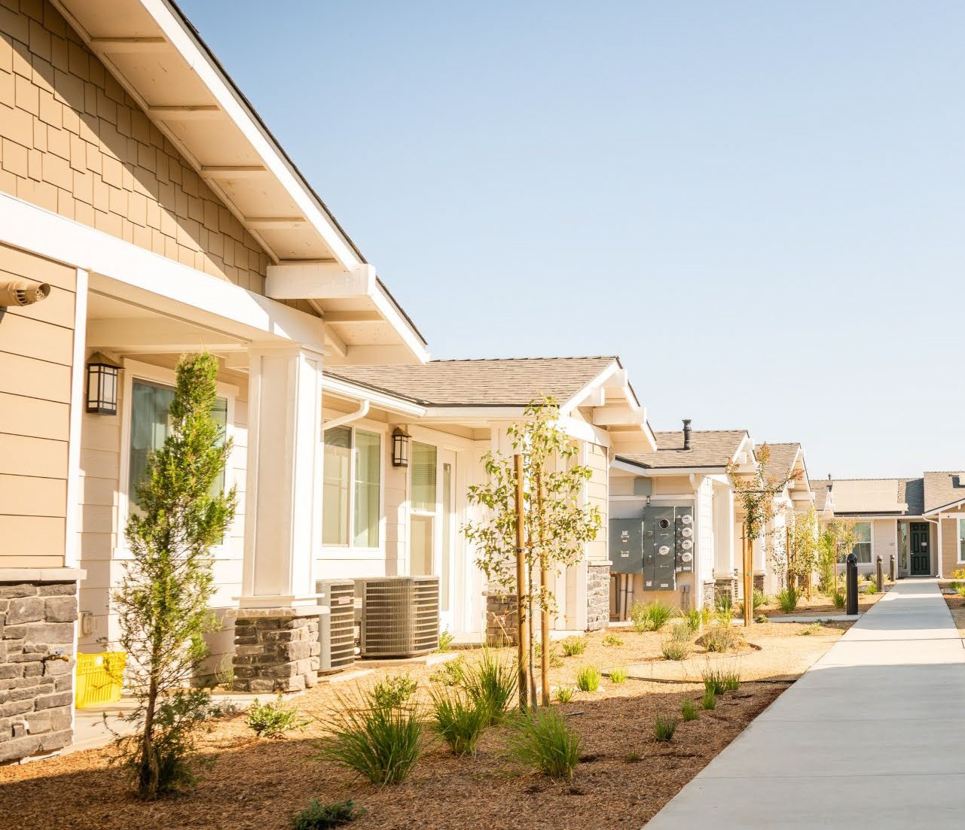
Housing Types in Fresno (city)
Source: Department of Finance, 2022.

Slide 19
Residents Experiencing Homelessness
4,216 people experienced homelessness in Fresno and Madera counties in 2022
Most live in the city of Fresno
Jurisdiction | Unsheltered | Sheltered | % Total Population Experiencing Homeless
Fresno City | 1,696 | 1,701 | 81%
Fresno County | 514 | 27 | 13%
Madera City | 73 | 150 | 5%
Madera County | 55 | 0 | 1%
Source: Fresno-Madera Continuum of Care, Point in Time Count, 2022.

Slide 20
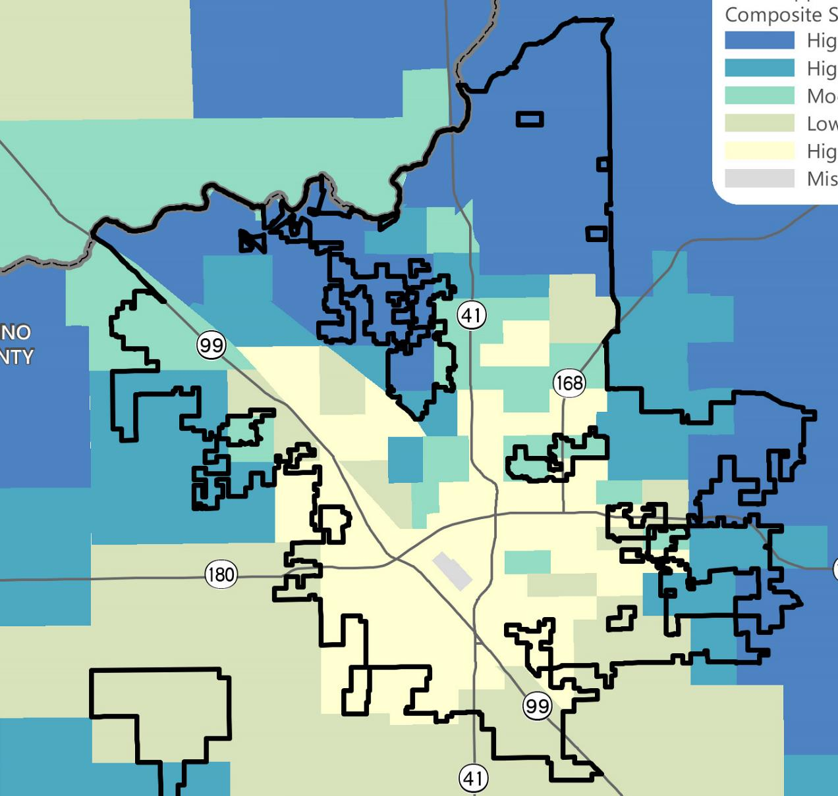
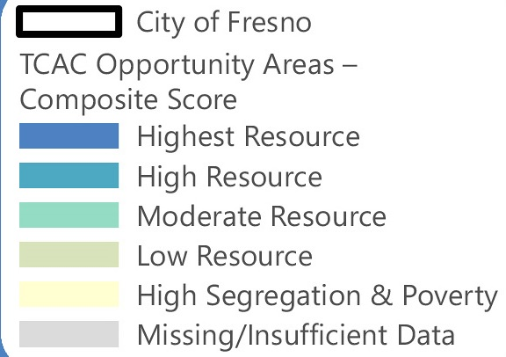
Fair Housing
AB 686 expands duty to affirmatively further fair housing (AFFH).
Housing Elements are required to:
Equitably include community in outreach process
Assess fair housing
Evaluate and address how sites will AFFH
Adopt policies and programs that remediate identified fair housing issues

Slide 21
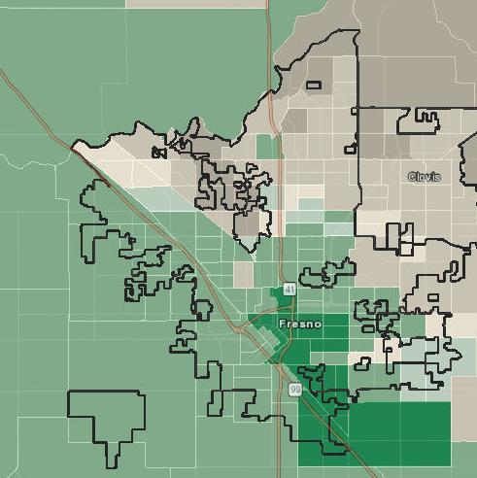
Predominant Race/Ethnicity by Census Tract
North and east Fresno is predominantly White
South and west Fresno is predominantly Hispanic
Hispanic population has increased over time
40% in 2000 to 50% in 2020
Hispanic Majority
Predominant (gap >50%)
Sizeable (gap 10%-50%)
Slim (gap < 10%)
White Majority
Predominant (gap >50%)
Sizeable (gap 10%-50%)
Slim (gap < 10%)

Slide 22
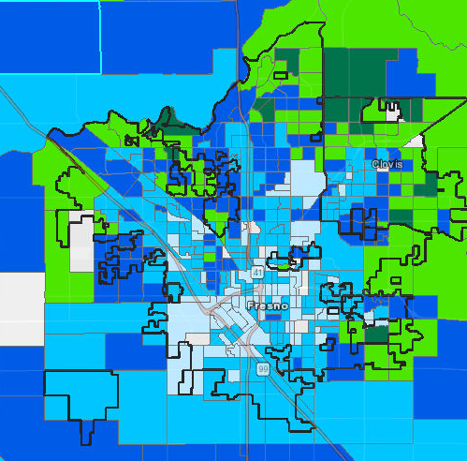
Median Income by Block Group
City of Fresno 2020 median household income = $53,368
Areas in the north and east have higher incomes than those in south and west Fresno.
Median Income
>$30,000
<$55,000
<$87,100
<$125,000
$125,000+
Source: American Community Survey 5 Year Estimates Data (2020)

Slide 23
Housing Element Success!
Permits issued for 13,892 housing units, including 959 affordable housing units since 2015
Local Housing Trust Fund established with $6.5 million dedicated to date
Nearly $2.5 million allocated for down payment assistance
5 free pre-approved plans available for residents to use to build accessory dwelling units (ADUs)
296 housing rehabilitation projects completed from 2016 to 2021
$827,000 available for mobile home rehabilitation and the City accepted responsibility for safety of mobile home parks through code enforcement and building permitting

Slide 24
Housing Element Success!
Landlord Incentive Pilot launched by the Housing Authority in March 2021 to increase Housing Choice Voucher Program Participation
Established Rental Housing Registry and Rental Inspection Program. 86,350 rental units registered, 13,375 inspections conducted, and many improvements to rental units completed.
Anti-displacement Task Force created and Here to Stay Report prepared
$75 million to administer homelessness initiatives from 2019-2020
City adopted a hotel to dwelling unit conversion ordinance and converted two hotels into dwelling units with many more projects in the works
$170 million in neighborhood associated infrastructure improvements spread over 189 park, sewer, street, traffic, and water projects

Slide 25
Discussion

Slide 26
Discussion Questions
What are Fresno’s greatest assets?
What do you think are the most critical housing issues in Fresno?
What groups within the community have the greatest housing needs?
What are Fresno’s most significant fair housing issues?
Do you have suggestions for addressing housing issues in Fresno?
Any suggestions for getting more community involvement?

Slide 27
Thank you

