Slide 1
Lub Nroog Fresno Kev Txhim Kho Vaj Tsev Chaw Nyob Ntau Qhov Chaw
Zej Zog Kev Sib Tham
Lub Yim Hli Hnub Tim 31, 2022

Slide 2
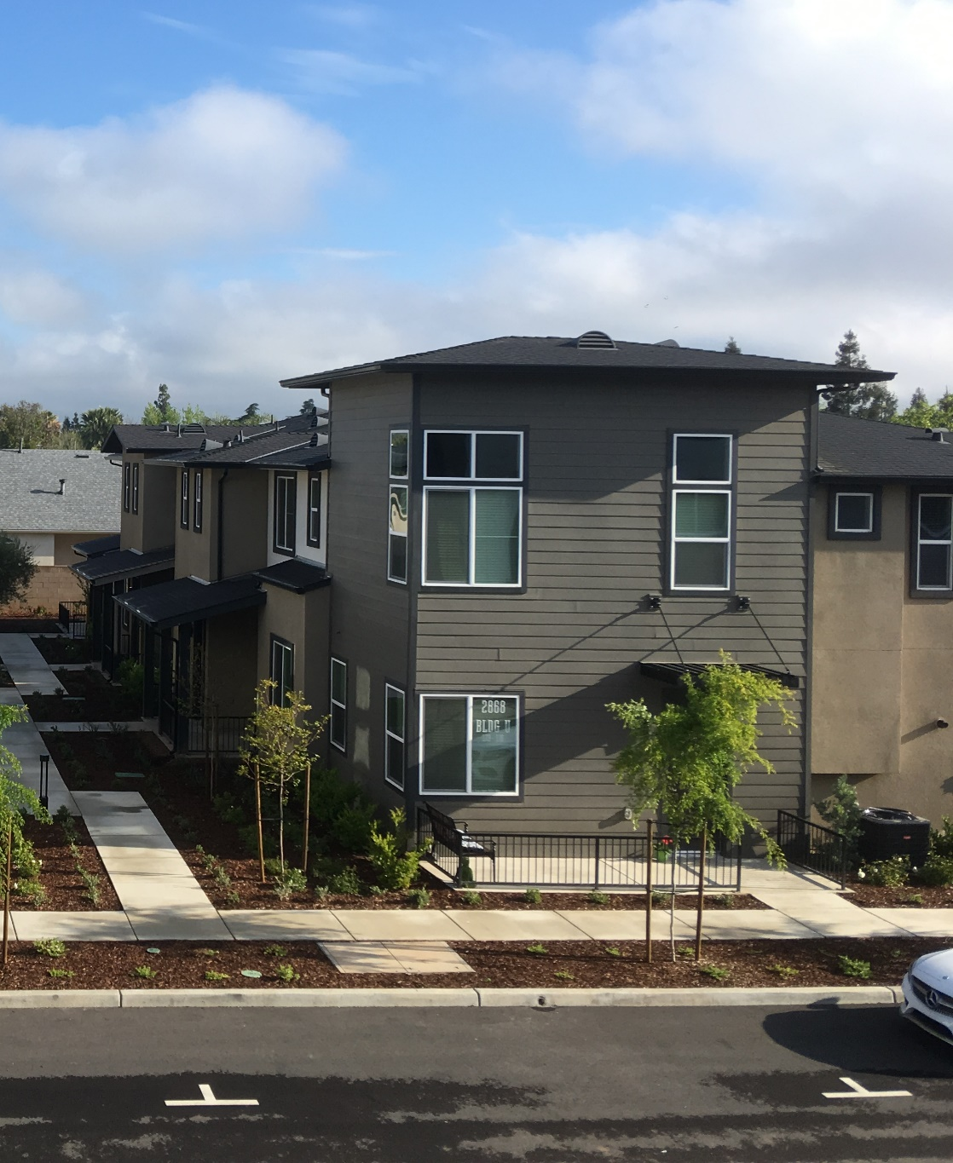
Cov Txheej Txheem
Cov Txheej Txheem Vaj Tsev Chaw Nyob/ Ntsiab Lus
Muab Kev Xav Tau Vaj Tsev Chaw Nyob Rau Hauv Cheeb Tsam (Regional Housing Needs Allocation RHNA)
Ntaub Ntawv Txog Ntawm Keeb Kwm Vaj Tsev Chaw Nyob
Kev Nthuav Qhia
Kev Tawm Qhia
Lub Nroog Fresno Kev Txhim Kho Vaj Tsev Chaw Nyob Ntau Qhov Chaw

Slide 3
Koom Kas Pab Pawg Neeg
TSOOM FWV PAWG SAAB LAJ NTAWM FRESNO
Fresno COG
Kristine Cai, Tus Lwm Thawj Coj
Simran Jhutti, Tus Lwm Npaj Dej Num Hauv Cheeb Tsam
Tus Kws Sab Laj Pab Pawg Neeg
Chaw Ua Hauj Lwm
Ascent
Provost thiab Pritchard
Kev Koom Tes Ntawm California Txhawm rau Cov Neeg Nyob Deb Nroog
Lub Nroog Fresno Kev Txhim Kho Vaj Tsev Chaw Nyob Ntau Qhov Chaw

Slide 4
Lub Ntsiab Lus Ntawm Kev Sib Tham
Muab kev nthuav qhia txog ntawm cov txheej txheem kev txhim kho vaj tsev chaw nyob
Qhia cov ntaub ntawv txog cov kev xav tau vaj tsev ntawm txhuas qhov chawm txhawm rau kev npaj
Khaw cov ntaub ntawv ntawm zej zog txog cov khoom vaj tsev, teeb meem, thiab cov tsam xeeb
Lub Nroog Fresno Kev Txhim Kho Vaj Tsev Chaw Nyob Ntau Qhov Chaw

Slide 5
Lub Ncaij Nyoog Ntawm Koom Kas
Nthuav qhia
Tus saib xyuas. Daim Ntawv Vaj Tsev Chaw Nyob
Muab Kev Tshuaj xyuas Daim Ntawv Vaj Tsev Chaw Nyob Rau Pej Xeem Txhua Tus(30-40 hnub)
Kev Soj Ntsuam Lees Txais
Xa Rau HCD – Tshuaj Xyuas Zaum 1 (90 hnub)
Nthuav qhia
Xa Rau HCD – Tshuaj Xyuas Zaum 2 (60 hnub)
Lub Xya Hli – Cuaj Hli 2022
Lub Ib Hli 2023
Lub Ob Hli 2023
Lub Kaum Ob Hli 2023
Lub Plaub Hli – Rau Hli 2023
Lub Ob Hli/Peb Hli 2023
Lub Yim Hli – Cuaj Hli 2023
Kev nthuav qhia thiab muab kev koom tes los ntawm pej xeem yuav raug ua thoob plaws hauv tus txheej txheem.
Lub Nroog Fresno Kev Txhim Kho Vaj Tsev Chaw Nyob Ntau Qhov Chaw

Slide 6
Cov Txheej Txheem Vaj Tsev Chaw Nyob/ Ntsiab Lus

Slide 7
Vaj Tsev Chaw Nyob Yog Dab Tsi?
Ib ntawm yim txoj cai tswj fwm ntawm Kev Npaj
Yuav tsum tau hloov kho txhua txhua 8 lub xyoo
Hnub Uas Tau Lees Txais: Lub Kaum Ob Hli Hnub Tim 31, 2023
Lub Sij Hawm Npaj Zaum 6: Lub Kaum Ob Hli Hnub Tim 31, 2023 – Lub Kaum Ob Hli Hnub Tim 31, 2031
Lub Sij Hawm Npaj Zaum 5: Lub Kaum Ob Hli Hnub Tim 31, 2015 – Lub Kaum Ob Hli Hub Tim 31, 2023
Npaj kom haum rau txoj kev cai “fair share“ (kev ncaj ncees) ntawm lub cheeb tsam uas xav tau vaj tsev chaw nyob
Lub Nroog Fresno Kev Txhim Kho Vaj Tsev Chaw Nyob Ntau Qhov Chaw

Slide 8
Ntsiab Lus Ntawm Vaj Tsev Chaw Nyob
Xav Tau kev Soj Ntsuam
Kev Tsuam Xyuas Kev Xav Tau Vaj Tsev– txheeb xyuas pej xeem, kev ua hauj lwm, thiab kev xav tau vaj tsev
Kev Tsuam xyuas vaj tsev yam ncaj ncees– txheeb xyuas cov teeb meem kom muaj vaj huam sib luag txog ntawm vaj tsev chaw nyob
Cov Chaw Nyob Vaj Tsev– txheeb xyuas qhov chaw uas muaj rau kev tsim kho los sis hloov kho vaj tsev
Kev Ntsuam Xyuas Kev Txwv– ntsuam xyuas tsoom fwv thiab cov tsis yog-tsoom fwv kev txwv kev txhim kho vaj tsev
Kev Ntsuam Xyuas Cov Vaj Tsev Nyob Yav Dhau Los – ntsuas kev nce qib thiab txheeb xyuas qhov sib rug
Txoj Cai thiab Txoj Hauj Lwm – tsim txoj cai thiab cov hauj lwm kom tau raws li cov kev xav tau vaj tsev chawm nyob
Kev Ntsuam Xyuas Vaj Tsev Chaw Nyob Yam Ncaj Ncees
Txoj Cai thiab Cov Hauj Lwm
Chaw Nyob Vaj Tsev
Cov Kev Txwv
Kev Soj Ntsuam
Lub Nroog Fresno Kev Txhim Kho Vaj Tsev Chaw Nyob Ntau Qhov Chaw

Slide 9
Muab Kev Xav Tau Vaj Tsev Chaw Nyob Rau Hauv Cheeb Tsam (Regional Housing Needs Allocation RHNA)

Slide 10
RHNA Raug Txiav Txim Li Cas?
Xeev Lub Luag Huaj Lwm
Cheeb Tsam Lub Luag Hauj Lwm
Zej Zog Lub Luag Hauj Lwm
Lub Xeev npaj ua hauj lwm rau yav tom txog ntawm kev xav tau vaj tsev chaw nyob rau ntau theem nyiaj tau los thiab faib rau cov COG thoob plaw hauv teb chaw
COG tsim ib txoj hauv kev los faib cov kev xav tau vaj tsev chaw nyob rau txhua qhov chaw; muab kev pom zoo los ntawm HCD
Lub nroog thiab lub xeev yog tus faib . Tom qab ntawv lawv yuav tsum nrhiav txoj hauv kev los txais kom haum - thaj av yuav tsum txaus rau qhov kom tsim nyog
RHNA Tag Nrho = 2,502,971
Fresno COG RHNA = 58,298
Tau Lees Txais Tham Lub Rau Hli 2022
Lub Nroog Fresno Kev Txhim Kho Vaj Tsev Chaw Nyob Ntau Qhov Chaw

Slide 11
Fresno COG RHNA
Cheeb tsam kev tswj fwv | Kev Faib RHNA | Feem Puas Ntawm Kev Faib RHNA
Clovis | 8,977 | 15%
Coalinga | 566 | 1%
Firebaugh | 443 | 1%
Fowler | 339 | 1%
Fresno City | 36,866 | 63%
Huron | 319 | 1%
Kerman | 1,063 | 2%
Kingsburg | 882 | 2%
Mendota | 642 | 1%
Orange Cove | 469 | 1%
Parlier | 733 | 1%
Reedley | 1,463 | 3%
Sanger | 1,494 | 3%
San Joaquin | 200 | <1%
Selma | 1,492 | 3%
Tsi tau suav nrog lub nroog Fresno | 2,350 | 4%
Lub Nroog Fresno Kev Txhim Kho Vaj Tsev Chaw Nyob Ntau Qhov Chaw

Slide 12
Lub Nroog Fresno RHNA Raws Li Hom Kev Tau Nyiaj Los
Hom Kev Tau Nyiaj Los | 2015-2023 RHNA (units) | 2023-2031 RHNA (units) | Feem Puas Nce Siab
Nyiaj tau los tsawg heev (<50% ntawm AMI) | 5,666 | 9,440 | 67%
Nyiaj tau los tsawg (51-80% of AMI) | 3,289 | 5,884 | 79%
Nyiaj tau los nruab nrab (81-120% ntawm AMI) | 3,571 | 5,638 | 58%
Siab duas nyiaj tau los nruab nrab (>120% ntawm AMI) | 11,039 | 15,904 | 44%
TAG NRHO | 23,565 | 36,866 | 56%
Tag Nrho 15,324 Tau Nyiaj Los Tsawg
Ntawm Kev Sib Piv:
Lub Nroog Clovis RHNA: 8,977
Lub Nroog Fresno RHNA: 2,350
2022 Cheeb Tsam Lub Nroog Fresno Hom Nyiaj tau los Nruab Nrab (AMI) xws li tsev neeg uas muaj 4 leeg = $80,300
Qhov Chaw Los: HCD 2022 Hom Nyiaj Tau Los; FCOG RHNA Cov Txheej Txheem, Lub xya hli 2022.
Lub Nroog Fresno Kev Txhim Kho Vaj Tsev Chaw Nyob Ntau Qhov Chaw

Slide 13
Ntaub Ntawv Txog Ntawm Keeb Kwm Vaj Tsev Chaw Nyob

Slide 14
Tsev Neeg Raws Li Hom Kev Tau Nyiaj Los
Qhov Chaw los: 2014-2018 CHAS
Lub Nroog Fresno Kev Txhim Kho Vaj Tsev Chaw Nyob Ntau Qhov Chaw

Slide 15
Kev Siv Nyiaj Ntawm Lub Nroog Fresno Yog Li Cas?
Cheeb tsam kev tswj fwv | Tus qis muag | $ nruab nrab Tsib hli 2022 | $ nruab nrab Tsib hli 2021 | % hloov ib xyoo ib zaug
Nroog Fresno (thoob plaws nroog) | 1,135 | $400,000 | $346,500 | 15.4%
Coalinga | 25 | $290,000 | $225,000 | 28.9%
Firebaugh | 13 | $305,000 | $310,000 | -1.6%
Fowler | 15 | $455,000 | $404,750 | 12.4%
Fresno | 685 | $389,500 | $325,000 | 19.8%
Kerman | 12 | $328,000 | $295,000 | 11.2%
Kingsburg | 25 | $451,000 | $325,000 | 38.8%
Mendota | 2 | $193,500 | $225,000 | -14.0%
Parlier | 8 | $267,500 | $283,500 | -5.6%
Reedley | 24 | $320,000 | $305,000 | 4.9%
Sanger | 21 | $371,000 | $400,000 | -7.3%
Selma | 17 | $300,000 | $272,500 | 10.1%
Cheeb tsam kev tswj fwv | Tus qis muag | $ nruab nrab Tsib hli 2022 | $ nruab nrab Tsib hli 2021 | % hloov ib xyoo ib zaug
Tsi tau suav nrog cheeb tsam lub nroog Fresno
Caruthers | 5 | $418,00 | $257,500 | 62.3%
Friant | 14 | $506,500 | $755,000 | -32.9%
Prather | 3 | $369,000 | $505,000 | -26.9%
Riverdale | 3 | $285,000 | $310,500 | -8.2%
Shaver Lake | 13 | $700,000 | $697,500 | 0.4%
Squaw Valley | 7 | $435,000 | $271,500 | 60.2%
Cheeb tsam kev tswj fwv | Tus qis muag | Qov nruab nrab
*Huron | 8 | $201,676
*Orange Cove | 25 | $329,796
*San Joaquin | 13 | $304,931
* Cov ntaub ntawv sau los ntawm kev soj ntsuam Zillow thiab Redfin
Qhov chaw los: CoreLogic, Kev Muag Khoom Hauv Tsev Hauv Nroog California (Ntsib Hli 2022) thiab Redfin thiab Zillow, 2021- 2022
Lub Nroog Fresno Kev Txhim Kho Vaj Tsev Chaw Nyob Ntau Qhov Chaw

Slide 16
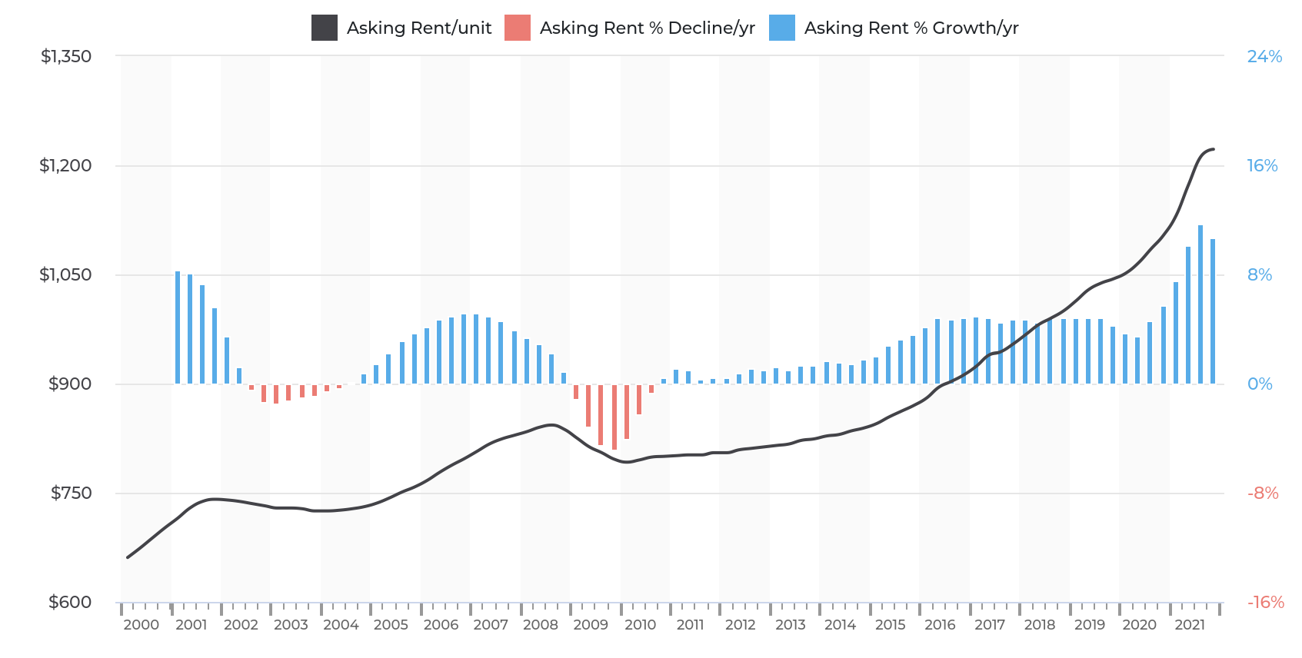
Kev Xauj Nyob Hauv Nroog Fresno
Nug qis xauj/chav
Nug qis xauj nqi %/xyoo
Nug qis xauj nce %/xyoo
Nug cov nqi tsev xauj hauv Nroog Fresno tau nce 10.7% ntawm Q4 2020 thiab Q4 2021.
Qhov chaw los: Kev Koom Tes Vaj Tsev Hauv Nroog California, 2022.
Lub Nroog Fresno Kev Txhim Kho Vaj Tsev Chaw Nyob Ntau Qhov Chaw

Slide 17
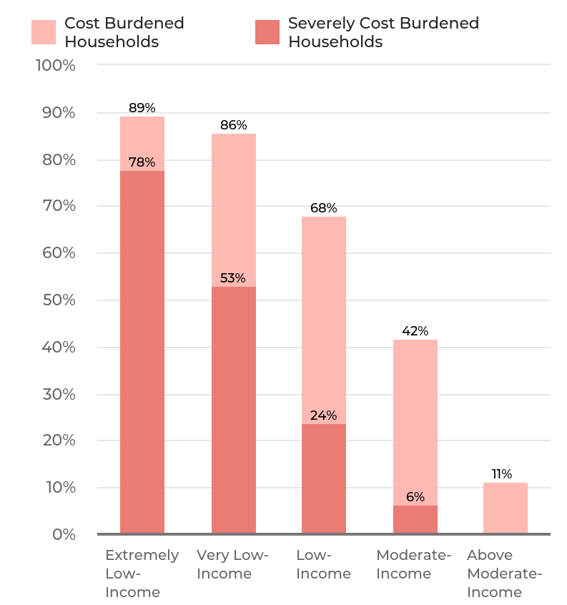
Leej twg yog tus tau txais kev puas tsuaj ntawm tus nqi vaj tsev siab hauv Nroog Fresno?
Kev rov qab them nyiaj rau nqi vaj tsev yog tsev neeg uas tau them nyiaj dhau sij hawm nyob
Tus nqi rov qab them = Them ntau duas 30% rau ntawm vaj tsev nyob
Tus nqi rov qab them uas ntau = Them ntau duas 50% rau ntawm vaj tsev nyob
Tsev neeg raug tus nqi rov qa them
Tsev neeg raug tus nqi rov qab them uas ntau
Tus Tswv
Tus Xauj
tus nqi rov qa them
tus nqi rov qa them uas ntau
Tau nyiaj los tsawg
heev li
Tau nyiaj los tsawg
heev
Tau nyiaj los tsawg
Tau nyiaj los nruab nrab
Tau nyiaj los ntau duas qub
Qhov Chaw Los: 2014-2018 CHAS thiab Kev Koom Tes Vaj Tsev Hauv Nroog California, 2022.
Lub Nroog Fresno Kev Txhim Kho Vaj Tsev Chaw Nyob Ntau Qhov Chaw

Slide 18
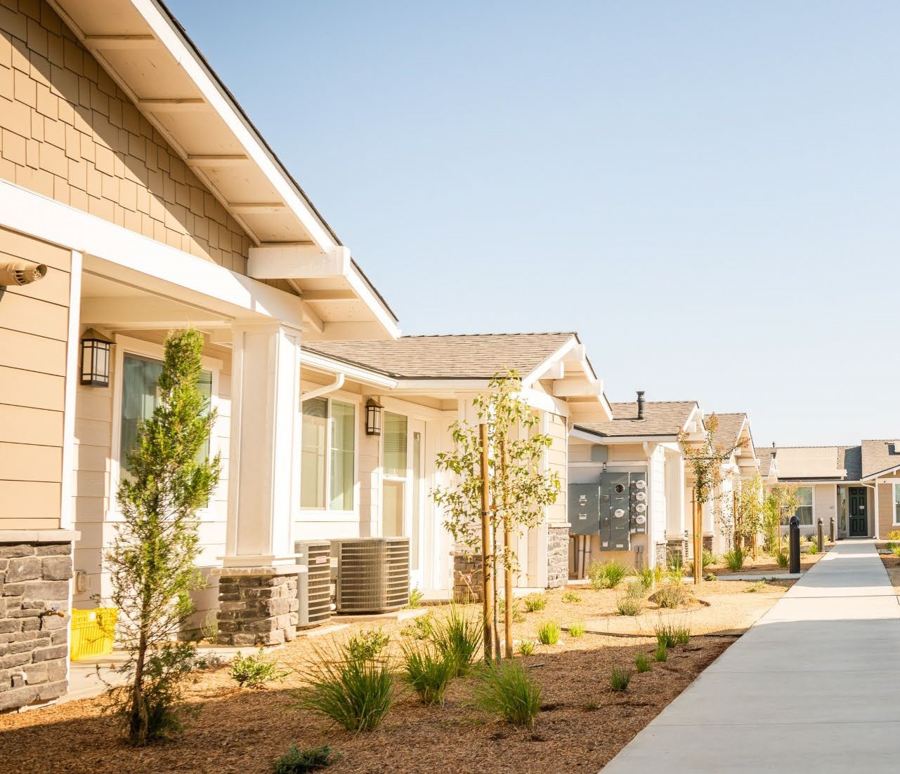
Hom Tsev Hauv Nroog Fresno
Ib tsev neeg
Ntau tsev neeg (2-4 chav)
Ntau tsev neeg (5+ chav)
Tsev me (mobile home)
Qhov Chaw Los: Lub Tsev Saib Xyuas Nyiaj Txiag, 2022.
Lub Nroog Fresno Kev Txhim Kho Vaj Tsev Chaw Nyob Ntau Qhov Chaw

Slide 19
Cov Neeg Tsi Muaj Vaj Tsev Nyob
4,216 leej neeg Tau ntsib kev tsi muaj vaj tsev nyob hauv nroog Fresno thiab nroog Madera hauv xyoo 2022
Feem ntau neeg nyob rau hauv nroog Fresno
Tsi muaj vaj tsev nyob
muaj vaj tsev nyob
Tag nrho cov tsi muaj vaj tsev nyob
Cheeb tsam kev tswj fwv | Tsi muaj vaj tsev nyob | Muaj vaj tsev nyob | % Tag Nrho Cov Neeg Tsi Muaj Tsev Nyob
Nroog Fresno | 1,696 | 1,701 | 81%
Xeev Fresno | 514 | 27 | 13%
Nroog Madera | 73 | 150 | 5%
Xeev Madera | 55 | 0 | 1%
Qhov Chaw Los: Fresno-Madera Continuum of Care, Point in Time Count, 2022.
Lub Nroog Fresno Kev Txhim Kho Vaj Tsev Chaw Nyob Ntau Qhov Chaw

Slide 20
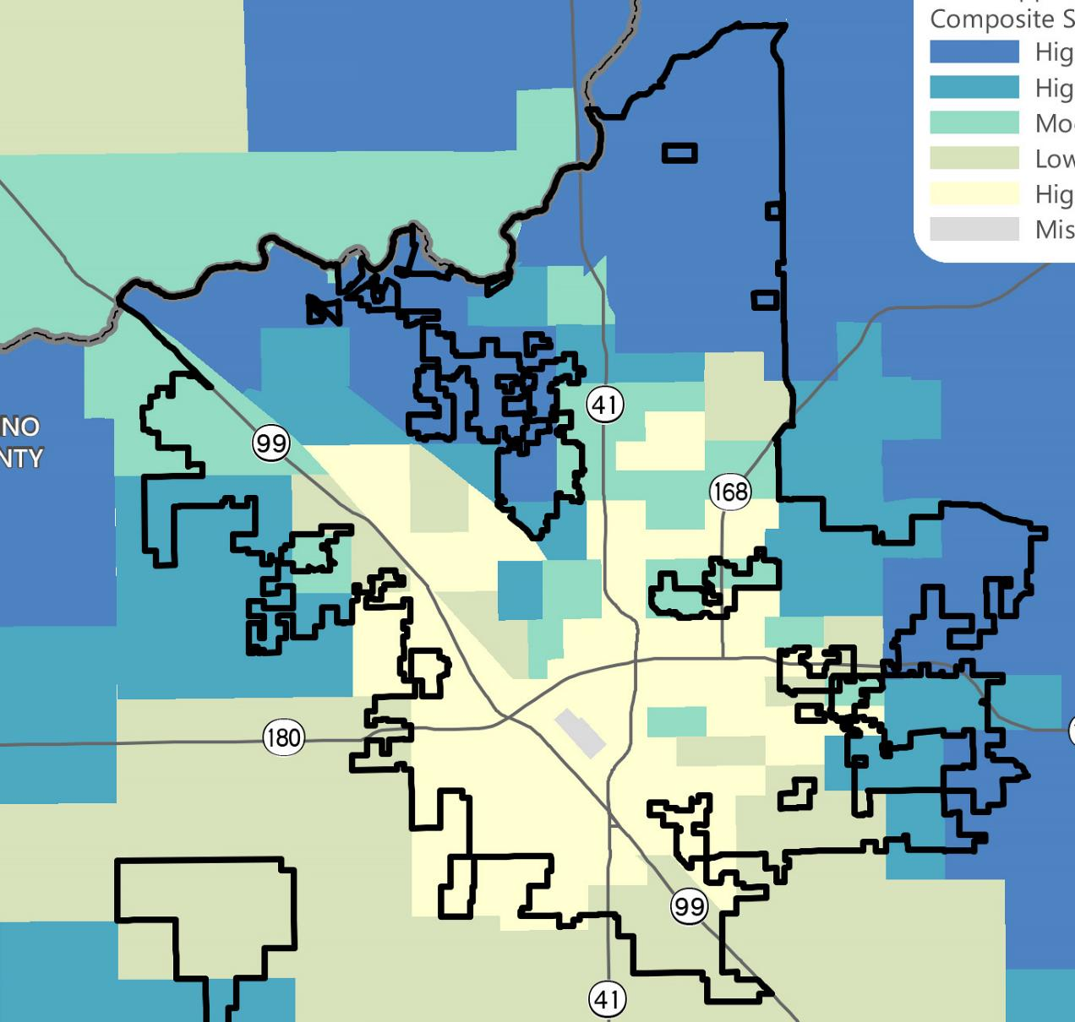
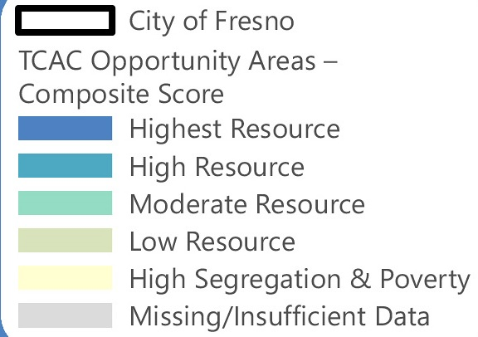
Vaj Tsev Nyob Uas Muaj Kev ncaj Ncees
AB 686 nthuav tawm lub luag hauj lwm txhawm rau los lees txais vaj tsev uas muaj kev ncaj ncees (AFFH).
Vaj tsev chaw nyob yog qhov yuav tsum muaj:
Muaj kev ncaj ncees suav nrog kev nthuav qhia hauv zej zog
Txheeb xyuas kev ncaj ncees ntawm vaj tsev
Ntsuam xyuas thiab muab kev daws teeb meem ntawm AFFH
Txais txoj cai thiab cov kev pab cuam uas kho cov teeb meem kev ncaj ncees ntawm vaj tsev
Lub nrog Fresno
TCAC cov chaw muaj feem cuam tshuam - cov qhab nia sib sau
cov peev txheej siab tshaj plaws
cov peev txheej siab nruab nrab
cov peev txheej nruab nrab
cov peev txheej tsawg
kev sib cais siab & kev txom nyem
cov ntaub ntawv ploj / tsis txaus
Lub Nroog Fresno Kev Txhim Kho Vaj Tsev Chaw Nyob Ntau Qhov Chaw

Slide 21
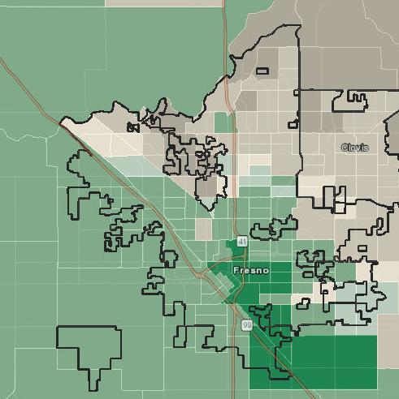
Haiv Neeg / Hom Neeg Uas Ros ntawm Kev Sau pej Xeem
Sab qaum teb thiab sab hnub tuaj ntawm Fresno feem ntau yog Neeg Xim Dawb
Sab qab teb thiab sab hnub poob Ntawm Fresno feem ntau yog neeg Hispanic
Cov neeg Hispanic tau nce ntxiv raws lub sij hawm
40% hauv 2000 txog 50% hauv 2020
Neeg Hispanic Feem ntau
Predominant (gap >50%)
Sizeable (gap 10%-50%)
Slim (gap < 10%)
Neeg Xim Dawb Feem tau
Predominant (gap >50%)
Sizeable (gap 10%-50%)
Slim (gap < 10%)
Lub Nroog Fresno Kev Txhim Kho Vaj Tsev Chaw Nyob Ntau Qhov Chaw

Slide 22
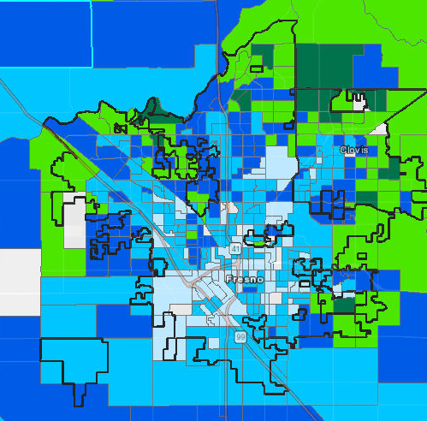
Hom nyiaj tau los nruab nrab ntawm Pag Pawg Block
Lub Nroog Fresno 2020 hom nyiaj tau los nruab nrab ntawm tsev neeg = $53,368
Cov cheeb tsam nyob rau sab qaum teb thiab sab hnub tuaj tau nyiaj ntau dua cov nyob rau sab qab teb thiab sab hnub poob ntawm nroog Fresno.
Hom nyiaj tau los nruab nrab
>$30,000
<$55,000
<$87,100
<$125,000
$125,000+
Qhov Chaw Los: Asmeskas Cov Ntaub Ntawv Kev Tshawb Fawb Hauv Zej Zog 5 Xyoo kwv yees (2020)
Lub Nroog Fresno Kev Txhim Kho Vaj Tsev Chaw Nyob Ntau Qhov Chaw

Slide 23
Vaj Tsev Chaw Nyob Uas Tiav!
Daim ntawv tso cai chaw nyob rau hnub tim 13,892 chav nyob, ntawm muaj 959 chav tsev pheej yig txij li xyoo 2015
Pob nyiaj pub rau cov vaj tsev hauv cheeb tsam tau siv nyiaj tsim $ 6.5 lab txhawm rau siv niaj hnub no
Ze li ntawm $ 2.5 lab uas raug faib rau kev pab them nqi tsev
5 lub phiaj xwm pub dawb tau pom zoo ua ntej muaj rau cov neeg nyob hauv siv los tsim cov khoom siv hauv tsev (ADU)
296 qhov kev kho vaj tsev chaw nyob uas tiav xyoo txij 2016 txog 2021
$827,000 muaj rau kev kho vaj tse me thiab Lub Nroog lees txais lub luag hauj lwm rau kev nyab xeeb ntawm cov chaw ua si hauv tsev los ntawm kev cai lij choj thiab kev tso cai hauv tsev
Lub Nroog Fresno Kev Txhim Kho Vaj Tsev Chaw Nyob Ntau Qhov Chaw

Slide 24
Vaj Tsev Chaw Nyob Uas Tiav!
Tus Tswv Tsav Dav Hlau tau pib qheb Lub Tsev Saib Xyuas Vaj Tsev chaw nyob rau lub Peb Hli 2021 txhawm rau Kev Xaiv Tsev
Tau Tsim Tsev thiab Koom Kas Txawm Rau Xauj. 86,350 chav tsev xauj no tau sau npe lawm, tau tshuaj xyuas tau tso cai lawm 13,375 chav tsev, thiab txhim kho ntau chav txhawm rau kom tiav thiaj tuaj yeem xauj tau.
Koom kas tiv thaiv kev kiav mus los tau tsim thiab kev nthuav qhia muaj nyob ntawm no
$75 lab txhawm rau tswj cov kev tsis muaj tsev nyob los ntawm xyoo 2019-2020
Lub nroog tau txais txoj cai los ntawm lub tsev nyob hauv txoj cai kev hloov dua siab tshiab thiab hloov ob lub tsev so rau hauv cov tsev nyob hauv nrog ntau yam hauj lwm ntxiv hauv kev ua hauj lwm
$170 lab nyob rau hauv zej zog uas cuam tshuam rau kev txhim kho kev ntauv dav tshaj 189 lub tiaj ua si, pas dej, txoj kev, kev tsheb hlau, thiab koom kas dej
Lub Nroog Fresno Kev Txhim Kho Vaj Tsev Chaw Nyob Ntau Qhov Chaw

Slide 25
Kev Tawm Qhia

Slide 26
Cov Lus Nug ntawm Kev Tawm Qhia
Nroog Fresno cov khoom muaj nqis tshaj yog dab tsi?
Koj xav li cas yog cov teeb meem vaj tsev tseem ceeb tshaj plaws hauv nroog Fresno?
Cov pab pawg twg hauv zej zog muaj kev xav tau vaj tse loj tshaj plaws?
Nroog Fresno qhov teeb meem tseem ceeb tshaj plaws ntawm tsev nyob yog dab tsi?
Koj puas muaj lus nug txog kev daws teeb meem vaj tsev nyob hauv nroog Fresno?
Puas muaj cov lus qhia kom tau txais kev koom tes hauv zej zog ntau dua?
Lub Nroog Fresno Kev Txhim Kho Vaj Tsev Chaw Nyob Ntau Qhov Chaw

Slide 27
Ua Tsaug

